Slide 1



AGE 214: Lecture 6
Diode Applications II: Filters & Zener Voltage Regulators
Sokoine University of Agriculture
AGE 214 - Lecture 6

Slide 2


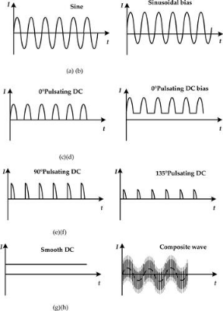
The Ripple Problem
Rectifier Output
Rectifiers produce Pulsating DC. This is not suitable for most electronics which require a steady "battery-like" voltage.
We need a filter to "fill in the gaps" between the pulses.
Sokoine University of Agriculture
AGE 214 - Lecture 6

Slide 3

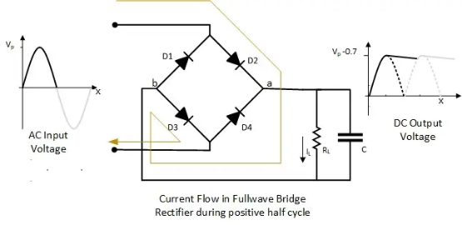
Capacitor Filter Circuit
Operation
•
A Capacitor (C) is placed in parallel with the load (R).
•
Charging: C charges to peak voltage ($V_m$) when diode conducts.
•
Discharging: C discharges through the load when diode is off, maintaining voltage.
Sokoine University of Agriculture
AGE 214 - Lecture 6

Slide 4
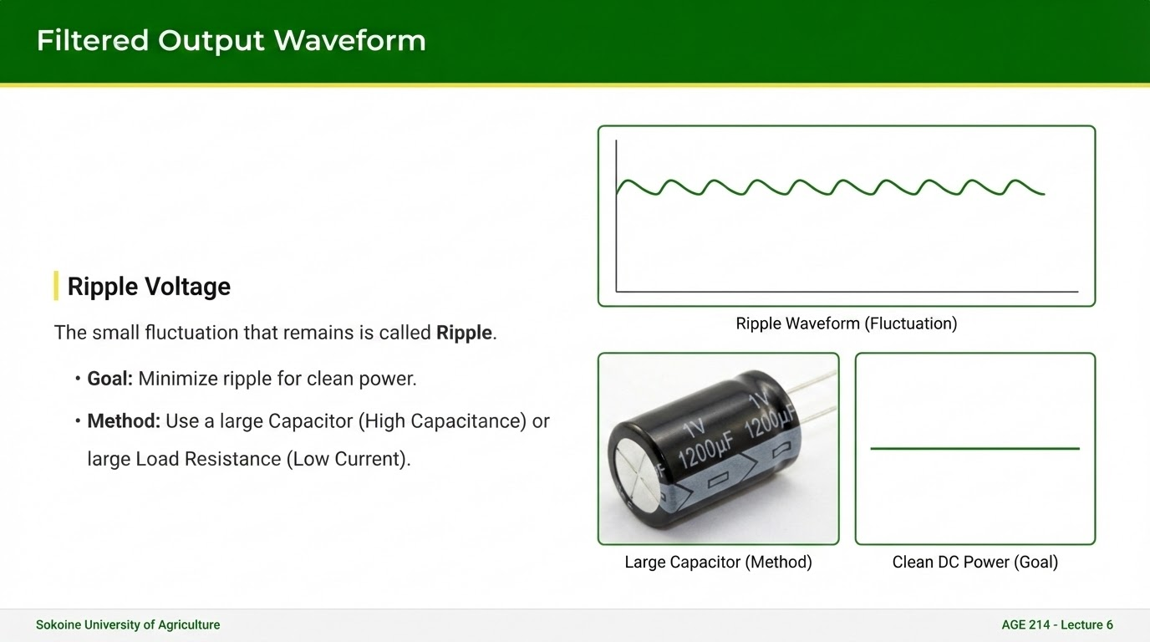

Slide 5




Calculating Ripple
Peak-to-Peak Ripple (V_{r})
For a Full-Wave Rectifier:
I_{dc}
f
C
Load Current
Frequency (100Hz)
Capacitance
Sokoine University of Agriculture
AGE 214 - Lecture 6

Slide 6
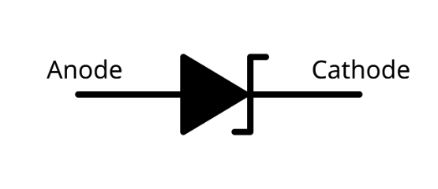
The Zener Diode
Introduction
A normal diode is destroyed if it breaks down in reverse bias. A Zener Diode is designed to operate safely in the breakdown region.
It acts as a constant voltage anchor.
Sokoine University of Agriculture
AGE 214 - Lecture 6

Slide 7
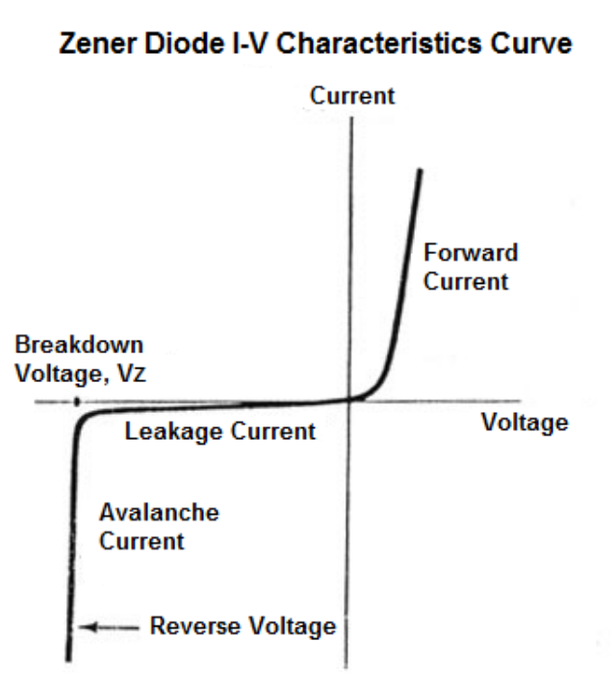
V-I Characteristic Curve
Notice the Zener Region (Quadrant 3):
•
At $V_Z$ (Zener Voltage), the curve is almost vertical.
•
Current changes drastically, but voltage stays constant.
•
This is the key to Voltage Regulation.

Slide 8
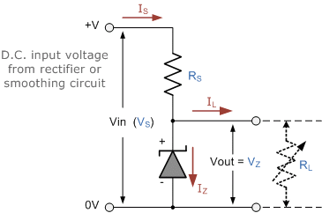
Zener Regulator Circuit
Construction
•
Series Resistor ($R_S$): Limits current from the source.
•
Zener Diode: Connected in Parallel with the load.
•
Polarity: Connected in Reverse Bias (Cathode to +).
Sokoine University of Agriculture
AGE 214 - Lecture 6

Slide 9

Regulation Principle
Input Increases
Load Changes
If $V_{in}$ rises, Zener current $I_Z$ increases. The extra voltage is dropped across $R_S$. Load voltage $V_L$ stays at $V_Z$.
If Load draws more current, Zener draws less. Total current stays roughly constant. Voltage is clamped at $V_Z$.
Sokoine University of Agriculture
AGE 214 - Lecture 6

Slide 10




Design Calculations
2. Zener Power
1. Series Resistor
Must be less than P_{max} rating.
Sokoine University of Agriculture
AGE 214 - Lecture 6

Slide 11
Questions?
Next Lecture: Diode Clippers & Clampers
Dr. Kadeghe Fue
Sokoine University of Agriculture
AGE 214 - Lecture 6

Slide 12






Image Sources
https://www.tandfonline.com/cms/asset/948855b7-d673-4228-83c8-ee19a0f0e4a2/gfer_a_2087259_f0001_b.jpg
Source: www.tandfonline.com
https://electric-shocks.com/wp-content/uploads/2019/06/Full-Bridge-Rectifier-Current-Flow-during-positive-Half-Cycle.webp
Source: electric-shocks.com
https://learning.uonbi.ac.ke/courses/SPH307/scormPackages/path_2/PIC.94.JPG
Source: learning.uonbi.ac.ke
https://upload.wikimedia.org/wikipedia/commons/thumb/7/7f/Zener_diode_symbol.svg/1280px-Zener_diode_symbol.svg.png
Source: wikimedia.org
http://www.learningaboutelectronics.com/images/Zener-diode-characteristics-curve.png
Source: www.learningaboutelectronics.com
https://www.electronics-tutorials.ws/wp-content/uploads/2013/08/diode24.gif?fit=364%2C242
Source: electronics-tutorials.ws

